Slide 1
VBA Challenge-Stock Analysis

Slide 2
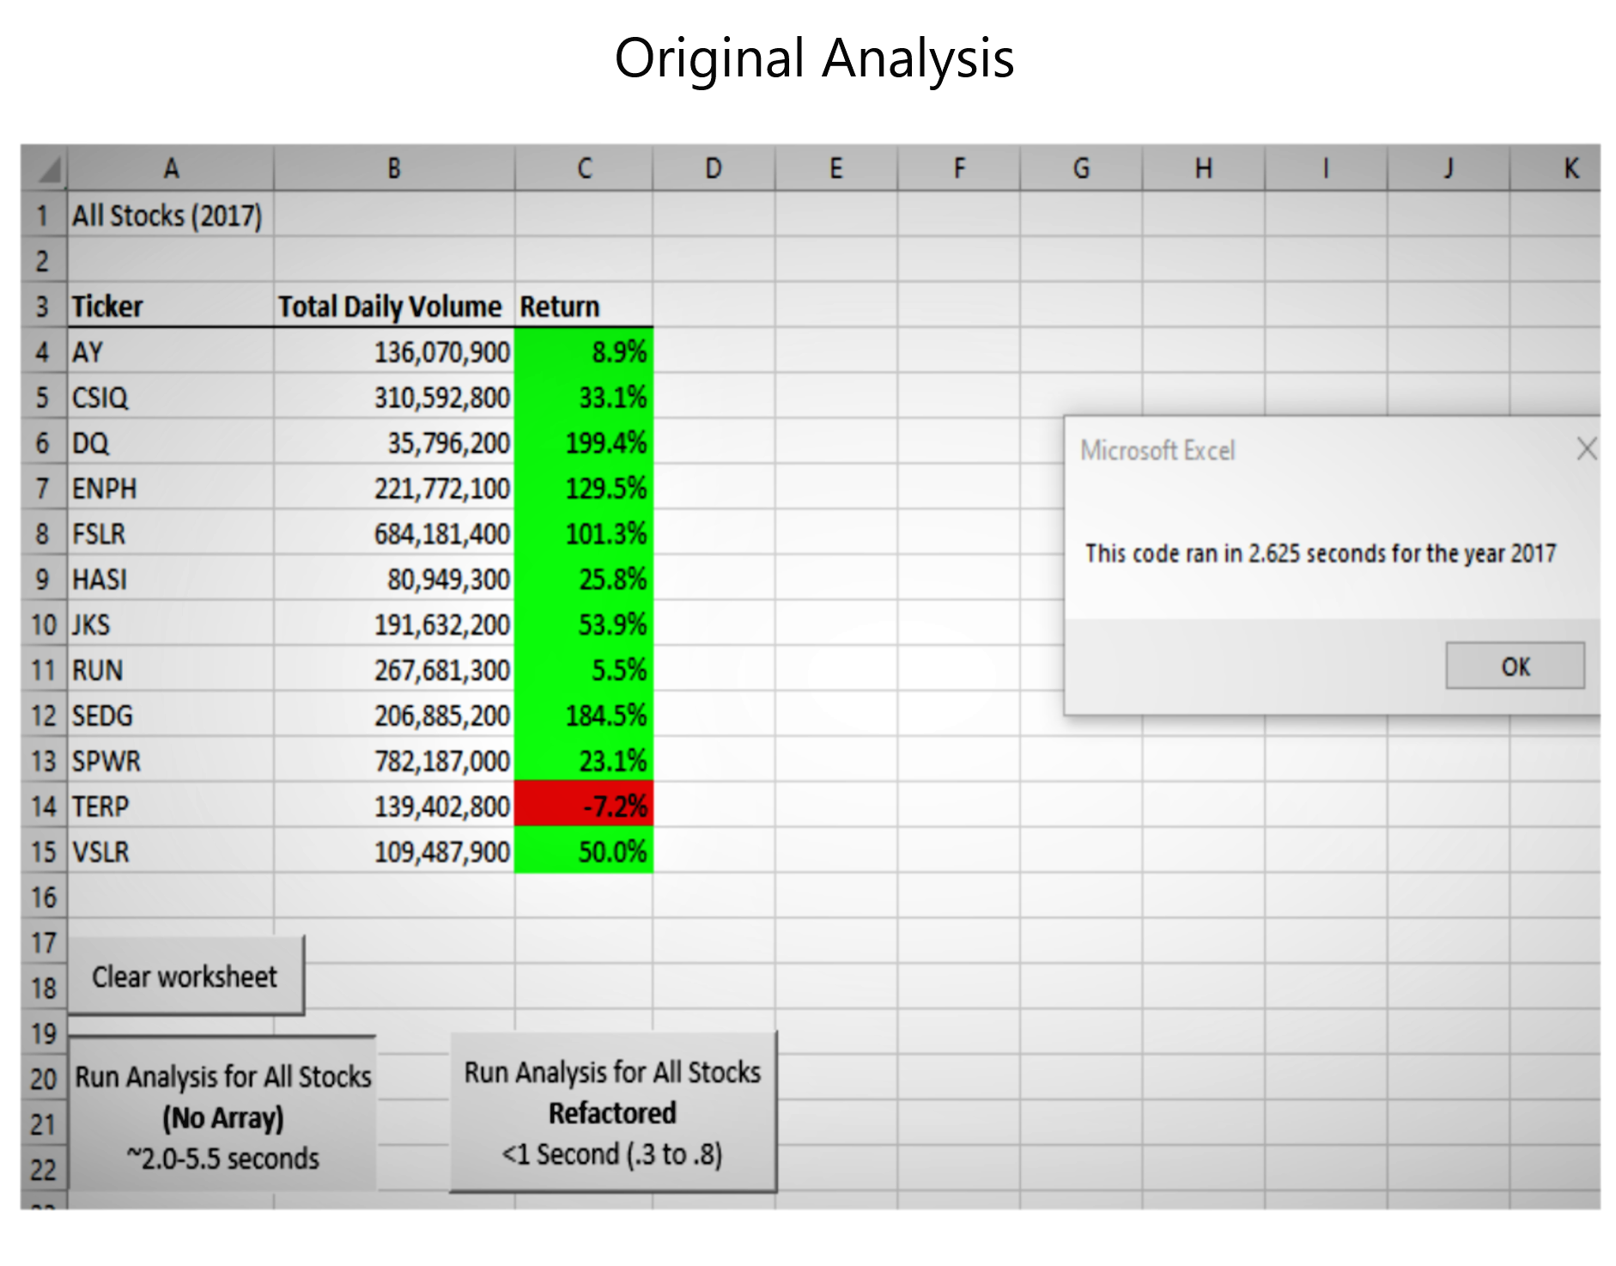
Original Stock Analysis-2017

Slide 3
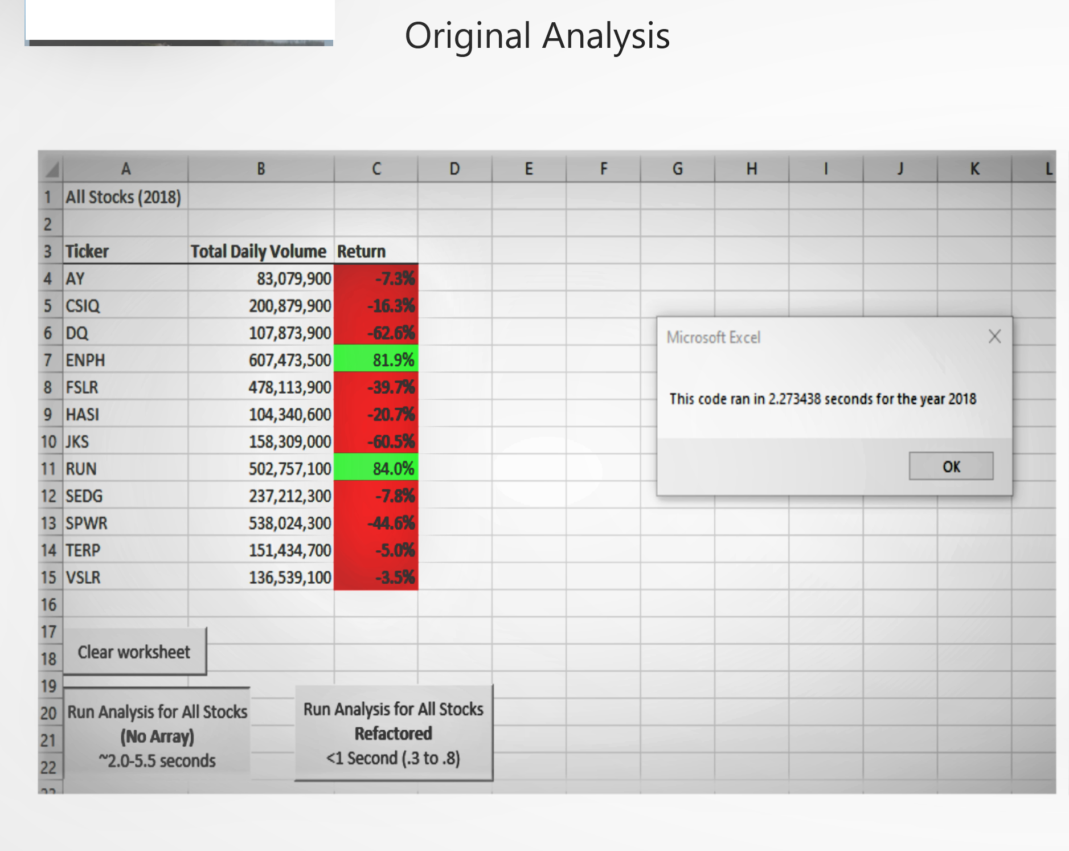
Original Stock Analysis-2018

Slide 4
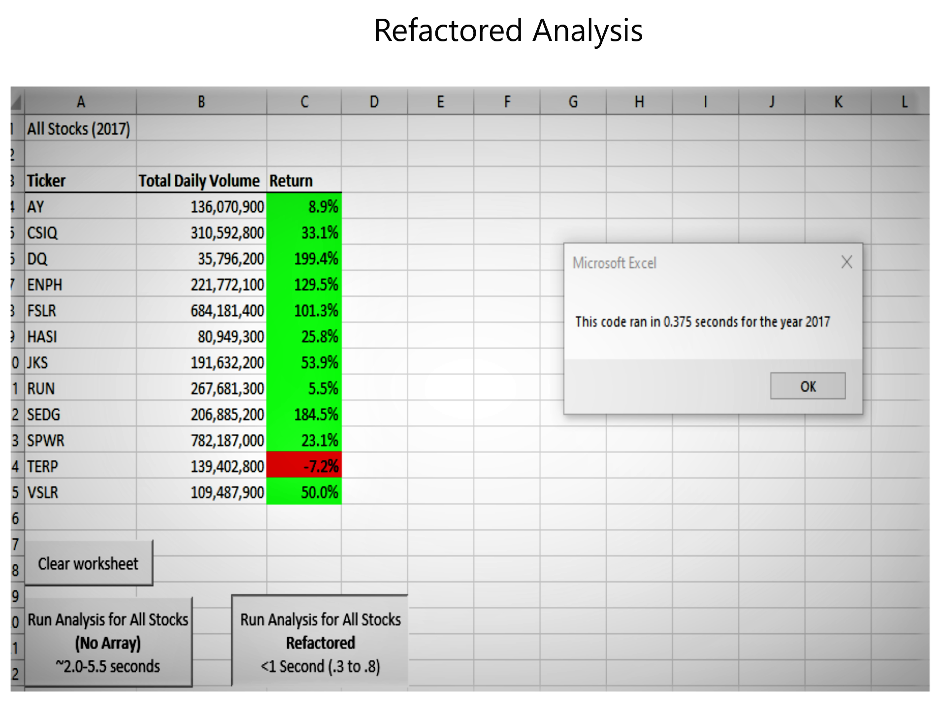
Refactored Stock Analysis-2017

Slide 5
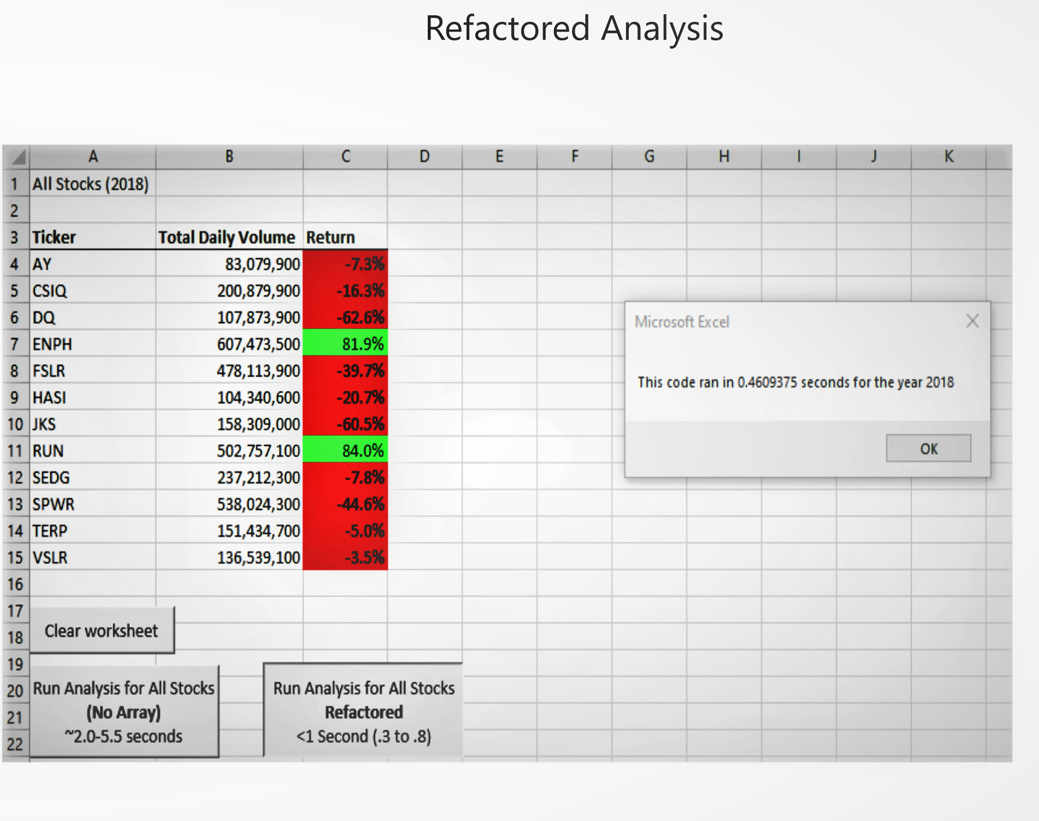
Refactored Stock Analysis-2018

